Slide 1
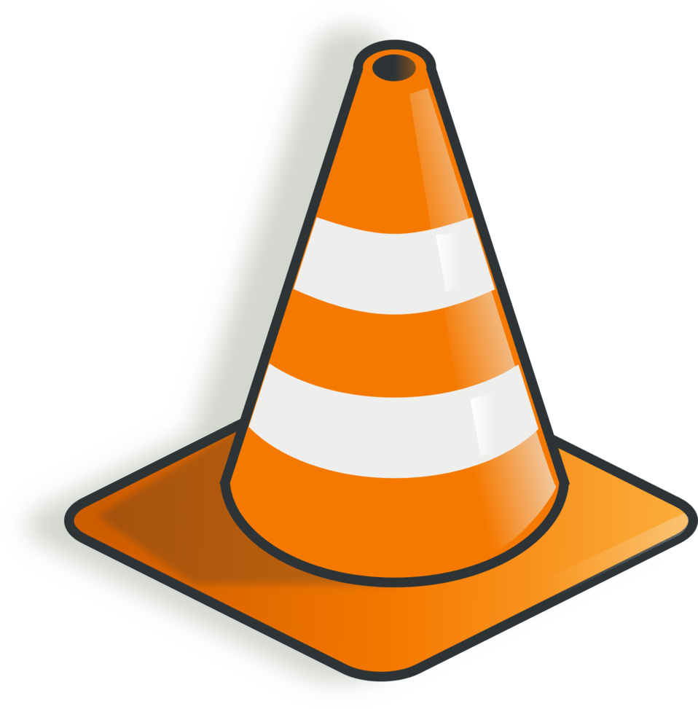
Work in Progress

Slide 2

Engineering Codex
Testing
d
g
x

Slide 3

Developers
I love E2E tests, because they are someone else’s problem
Managers
E2E tests simulate real user scenarios, and make it easy to understand the impact of a problem in the real world
Tester
Writing tests from a user’s perspective means i won't waste time testing things that don't matter, and i won't miss anything that does. I also feel great knowing I’ve made a users experience with us better.
End to End Tests are Seductive

Slide 4
End to End Tests are Hard
E2E tests are expected to simulate a real user experience.
It stands to reason that they must be executed in an environment that is as close to the real world as possible, in order to provide the closest simulation possible.
Production systems are complex and time consuming to create, recreating them to run E2E tests makes E2E test expensive and time consuming to run.
An End to End test requires testing the whole system in a place that looks like production

Slide 5
Test Pyramid
More
Integration
Exploratory
Slower
End-to-End
Component
Integration
Unit
Less
Integration
Faster
Test Pyramid by Toby Clemson on Martin Fowler's Blog

Slide 6
Testing Scopes
Ad Hoc tests that span as far and wide as a testers intuition allows
Exploratory
Tests that span across multiple domains as a result of a user interaction
End-to-End
Tests that span across multiple apps of a single subdomain
Component
Tests that are isolated to a single application or service
Integration
Tests that are isolated to a single class or function
Unit

Slide 7
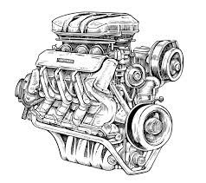
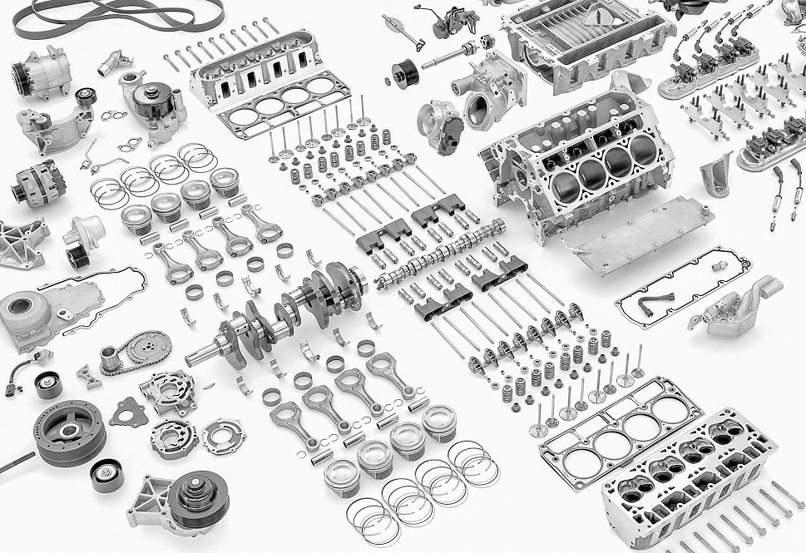
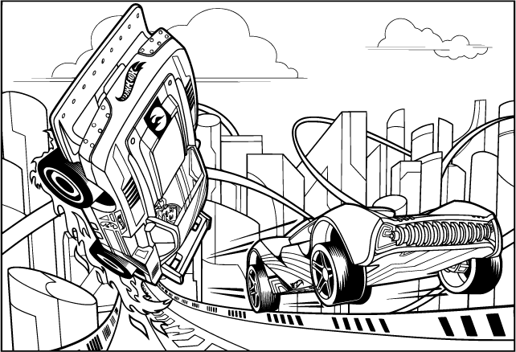
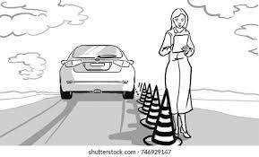
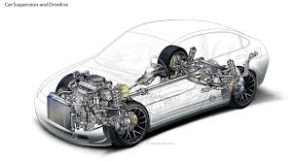
Using the Testing Pyramid to Build a Car
Unit Testing
Check each individual component, to ensure each one functions correctly on its own.
Integration Testing
Assemble your engine, using your components, to ensure they work seamlessly together.
End-to-End Testing
Take you car for a test drive, to ensure it operates smoothly from start to finish.
Component Testing
Attach your engine to the rest of the drivetrain, to ensure that the entire system functions properly.
Exploratory Testing
Hand over the keys to a skilled driver to take the car for a spin, to discover any unexpected issues or areas for improvement.

Slide 8
Using the Testing Pyramid to Build Software
Unit Testing
Focuses on testing small, isolated pieces of code (functions or methods) to verify they work as expected.
Integration Testing
Tests the interaction between different modules or components to ensure they work together correctly.
End-to-End Testing
Tests the entire application flow from start to finish to ensure all parts of the system work together as expected.
Component Testing
Focuses on testing larger parts of the application, such as a single service or component, in isolation from the rest of the system.
Exploratory Testing
Involves manually testing the application by exploring its functionality and behavior to identify defects that automated tests might miss.

Slide 9
Reset your Data Before Every Test Scenario Execution

Slide 10
Unit Tests
Focus | typically a single class or function
Coverage | comprehensive, 80+ %
Boundaries | class or function level isolation, tenant page, organism, molecule, atom
Dependencies | mock
Tools | language specific unit testing tools
Troubleshooting | very fast, ide, logging
Execution Environment | local, ci
Automation | ci
Owner | app engineers

Slide 11
Integration Tests
Focus | microservice apis, event consumers
Coverage | all endpoints and consumers, happy-path, errors
Boundaries | microservice, tenant page, organism, molecule
Dependencies | docker, emulators, mock http servers
Tools | testcontainers, language specific unit testing tools
Troubleshooting | fast, ide, logging
Execution Environment | local, ci
Automation | ci
Owner | app engineer

Slide 12
Component Tests
Focus | microservice apis, event consumers
Coverage | all endpoints and consumers, typically happy-path
Boundaries | sub-domain, tenant pages, organisms
Dependencies | internal services, external mock servers, databases, app topics, test topics
Tools | separate repo, engineering teams choice
Troubleshooting | medium speed, metrics, traces, logs
Execution Environment | k8s, sbx
Automation | on deploy (argo post-sync)
Owner | app engineer

Slide 13
End-to-End
Focus | end-to-end internal and external service integrations
Coverage | happy-path
Boundaries | global, tenant user journey
Dependencies | gdx, enterprise, 3rd parties, mock servers (in certain cases)
Tools | separate repo, qa engineers choice
Troubleshooting | slow, metrics, traces, logs
Execution Environment | k8s, tst, prd
Automation | cron, manual
Owner | qa engineer

Slide 14
Exploratory
Focus | discovery
Coverage | minimal, ad-hoc
Boundaries | global, tenant user journey
Dependencies | gdx, enterprise, 3rd parties
Tools | manual
Troubleshooting | slow, metrics, traces, logs
Execution Environment | tst, prd
Automation | manual
Owner | none

Slide 15
Component Load Tests (TODO)
Focus | microservice apis, event consumers
Coverage | all endpoints and consumers, typically happy-path
Boundaries | sub-domain, tenant page
Dependencies | internal services, external mock servers, databases, app topics, test topics
Tools | separate repo, engineering teams choice
Troubleshooting | medium speed, metrics, traces, logs
Execution Environment | k8s, sbx
Automation | on deploy (argo post-sync)
Owner | app engineer

